Slide 1

7th Grade Math
Unit 7, Lesson 4 Interpreting Circle Graphs Volume 1, pg. 308

Slide 2


Benchmark
MA.7.DP.1.4
Use proportional reasoning to construct, display, and interpret data in circle graphs.
volume 1, pg. 308

Slide 3
Integrated Mathematical Thinking and Reasoning Standards
MA.K12.MTR.3.1 Complete tasks with mathematical fluency.
MA.K12.MTR.6.1 Assess the reasonableness of solutions.
MA.K12.MTR.7.1 Apply mathematics to real-world contexts.
volume 1, pg. 308

Slide 4

Learning Target
I can interpret the data in a circle graph.
volume 1, pg. 308

Slide 5

Warm-Up
volume 1, pg. 309

Slide 6
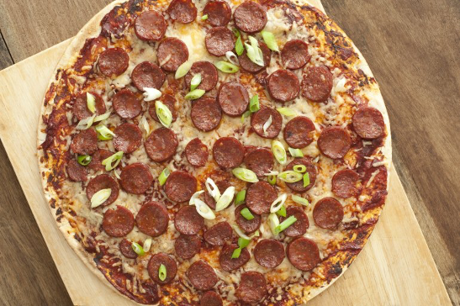
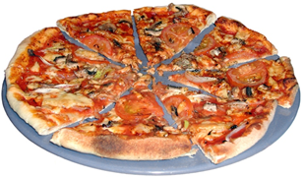
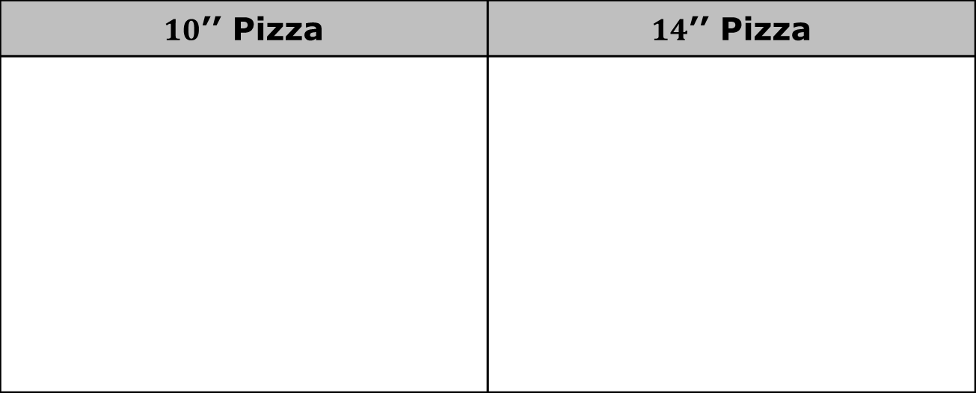
7.4.1 Warm-Up: Would You Rather?
A 10-inch pizza with 8 slices and a 14-inch pizza with 10-slices were ordered for a party.
$10$’’ Pizza | $14$’’ Pizza
volume 1, pg. 309

Slide 7
Would you rather have a slice from the 10″ pizza, or a slice from the 14″ pizza?
Explain your choice or justify it by showing your work.
volume 1, pg. 309

Slide 8

Guided Instruction
volume 1, pg. 309

Slide 9
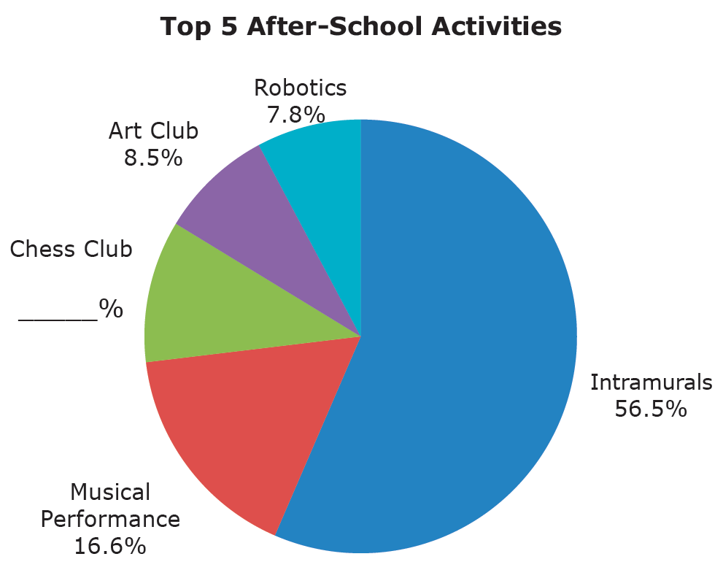
7.4.2 Guided Instruction: Interpreting a Circle Graph
The graph reflects the top five after-school activities at the Capital City Recreation Center based on the number of participants for each activity.
Fill in the missing percent for Chess Club.
volume 1, pg. 309

Slide 10
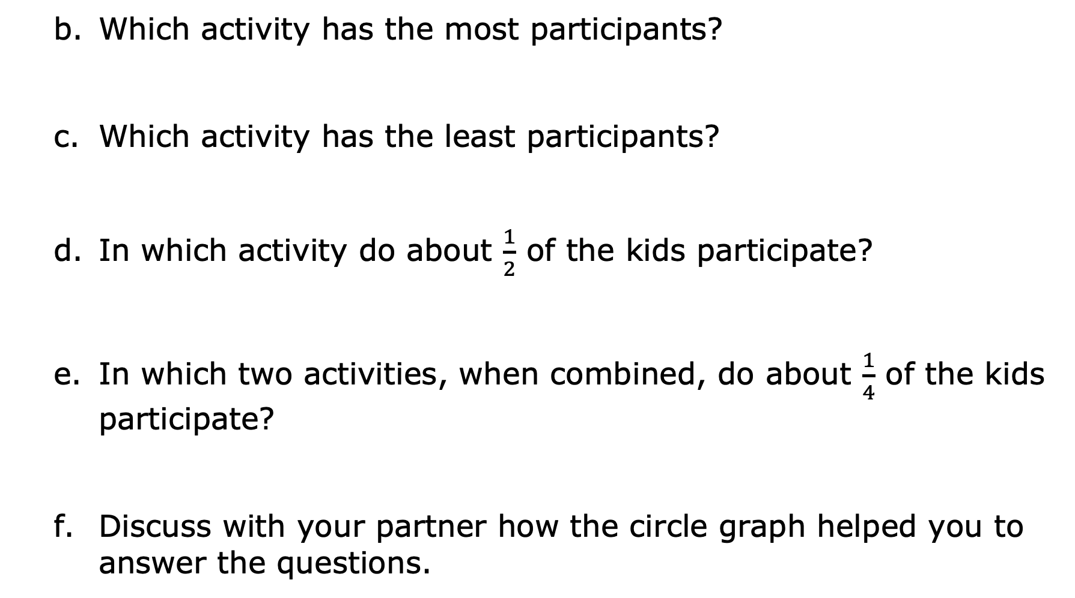
Which activity has the most participants?
Which activity has the least participants?
In which activity do about $\frac{1}{2}$ of the kids participate?
In which two activities, when combined, do about $\frac{1}{4}$ of the kids participate?
Discuss with your partner how the circle graph helped you to answer the questions.
volume 1, pg. 309

Slide 11
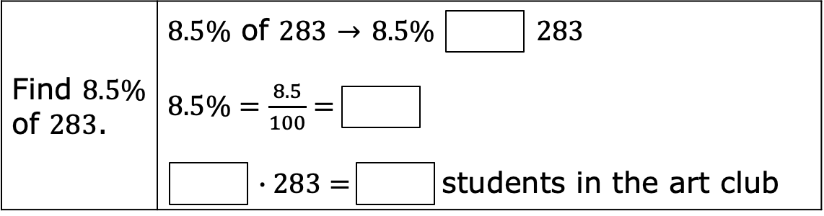
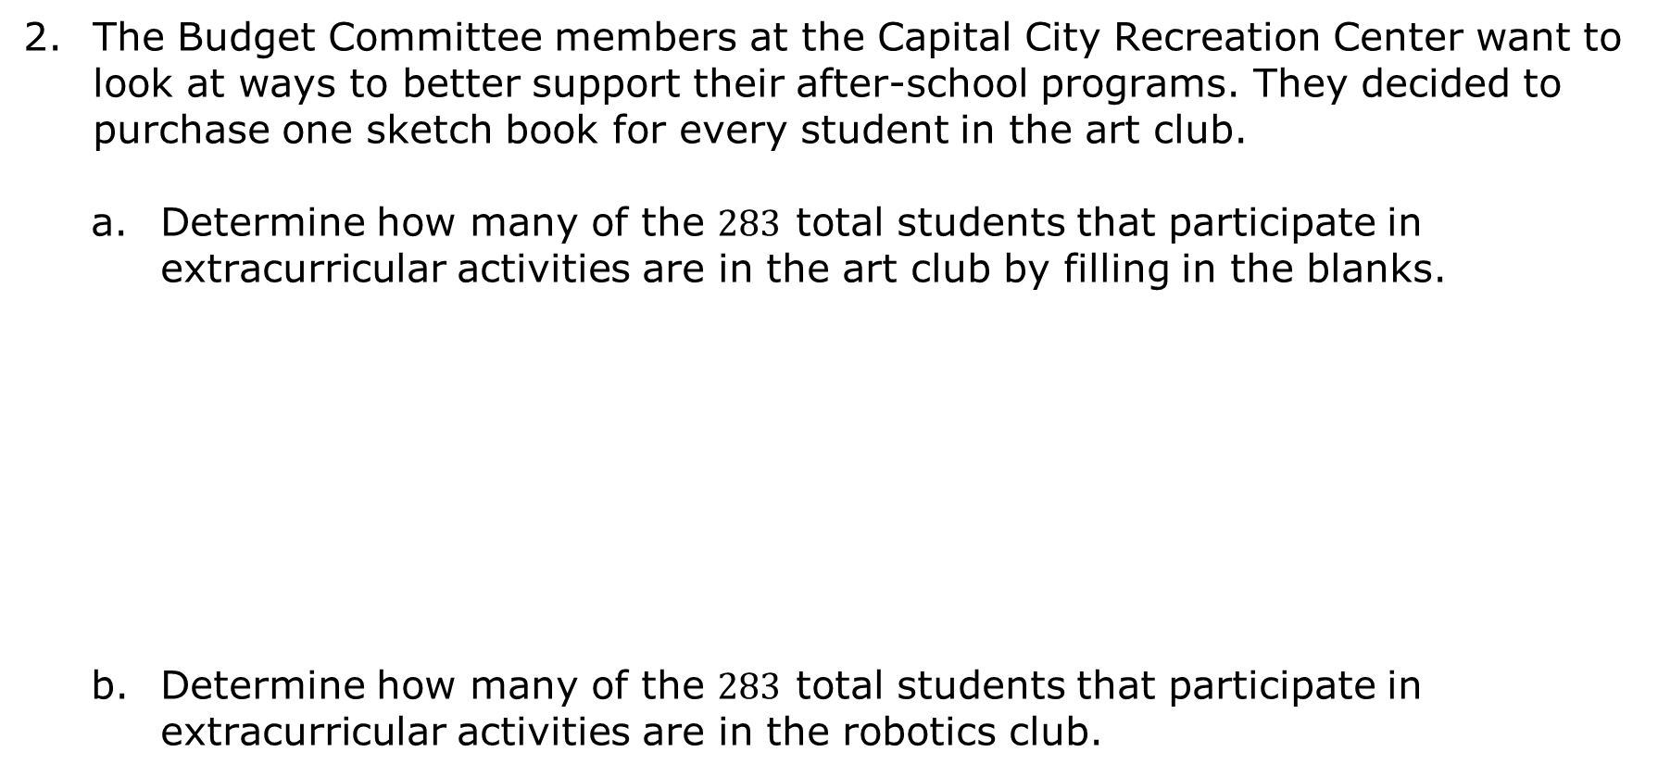
The Budget Committee members at the Capital City Recreation Center want to look at ways to better support their after-school programs. They decided to purchase one sketch book for every student in the art club.
Determine how many of the $283$ total students that participate in extracurricular activities are in the art club by filling in the blanks.
Determine how many of the $283$ total students that participate in extracurricular activities are in the robotics club.
volume 1, pg. 310

Slide 12

Collaboration
volume 1, pg. 311

Slide 13

7.4.3 Collaboration: What Does the Graph Say?
Determine with your partner who will be partner A and who will be partner B. Partners A and B will be given two different ingredient lists for two popular holiday snack mixes and a blank circle. Do not let your partner see your list.
Use your recipe to fill in the chart. Then, construct a circle graph for your recipe using the circle provided. Round each percent to the nearest tenth and angle measure to the nearest whole number.
volume 1, pg. 311

Slide 14
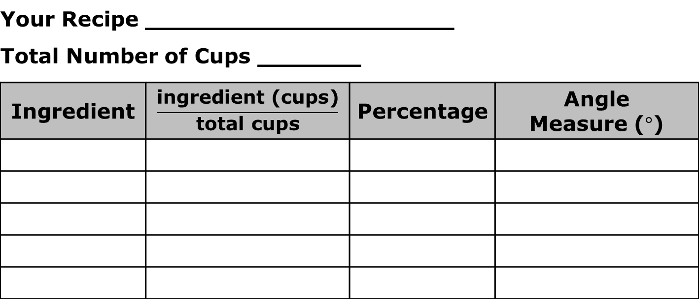
Your Recipe _____________________ Total Number of Cups _______
Ingredient | $$\frac{\text{ingredient}\text{ (}\text{cups}\text{)}}{\text{total} \text{cups}}$$ | Percentage | Angle Measure ($°$)
Exchange only your completed circle graph with your partner and use your partner’s completed circle graph to answer the following questions.
Which ingredient was used most in your partner’s recipe?
volume 1, pg. 311

Slide 15
Which ingredient was used least?
Record your observations about any similarities or differences between your graph and your partner’s graph.
volume 1, pg. 311

Slide 16
Complete the table by using your partner’s graph to calculate the number of cups necessary for each ingredient.
Explain the process you used to determine the number of cups for each ingredient in your partner’s recipe.
Partner’s Recipe _____________________ Total Number of Cups Used _______
Ingredient | Number of Cups
volume 1, pg. 311

Slide 17

Your Turn
volume 1, pg. 312

Slide 18
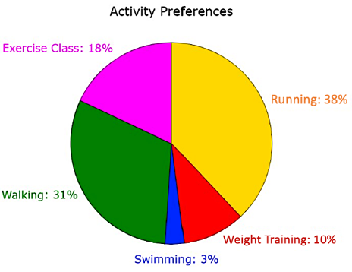
7.4.4 Your Turn!
A health club surveyed $500$ of its members to determine which activities they come to the club to participate in. Use the graph to answer the questions.
volume 1, pg. 312

Slide 19
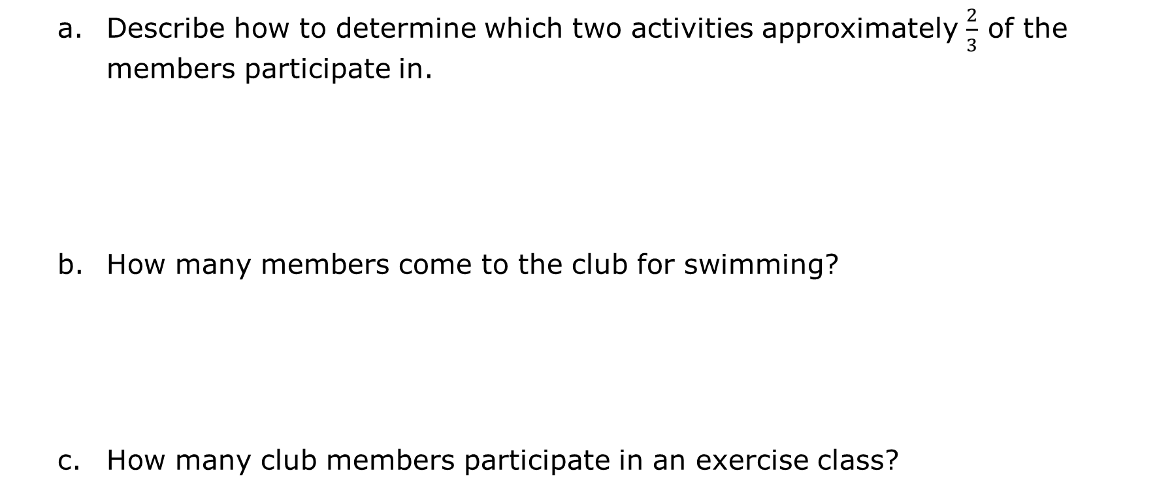
Describe how to determine which two activities approximately $\frac{2}{3}$ of the members participate in.
How many members come to the club for swimming?
How many club members participate in an exercise class?
volume 1, pg. 312

Slide 20

Wrap-Up
volume 1, pg. 312

Slide 21
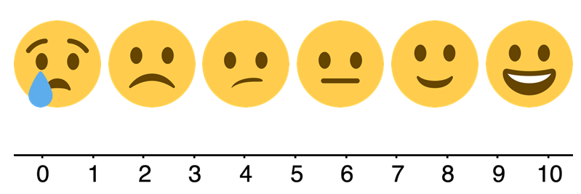
7.4.5 Wrap-Up: Reflection
Choose the emoji that reflects your understanding of interpreting data in a circle graph.
volume 1, pg. 312

Slide 22
Complete the statement.
I chose this emoji because ______________________________
____________________________________________________
____________________________________________________
____________________________________________________
volume 1, pg. 312

